Slide 1
What Makes a Legitimate TMS Job?
May 2026

Slide 2
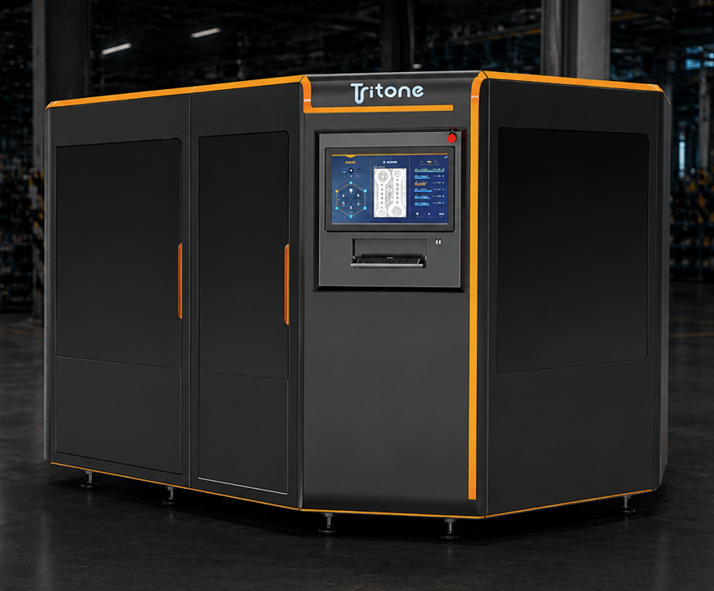
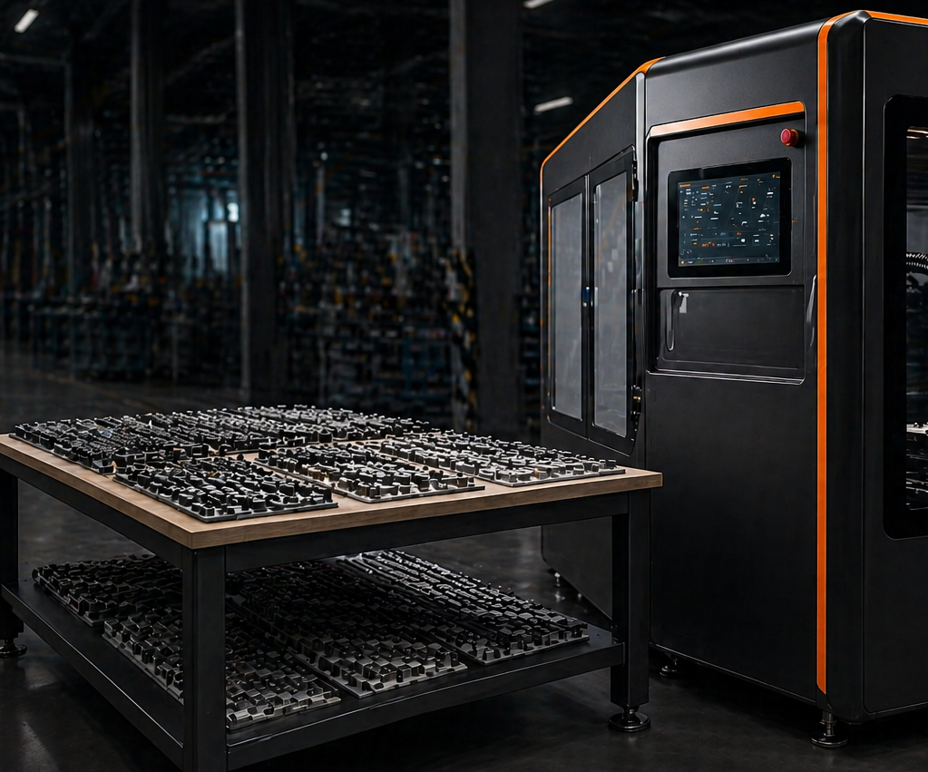
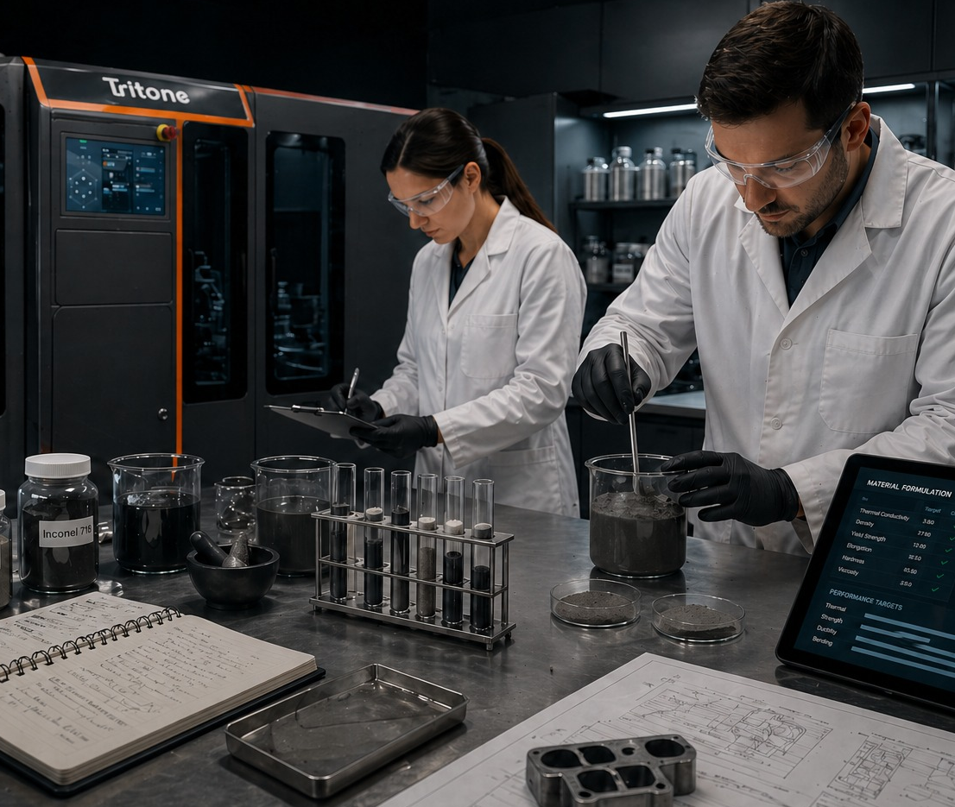
Our Solutions
Tritone Manufacturing Service (TMS)
AM Systems
Parts on Demand
Development Projects
This document is Tritone intellectual property; any copy is strictly prohibited

Slide 3
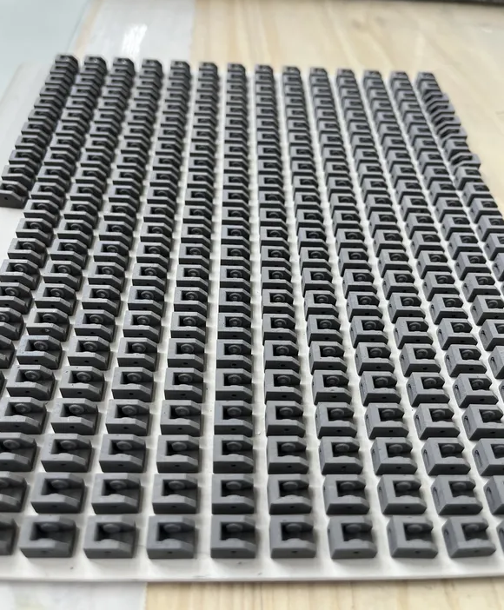
Our Solutions
AM Systems
Development Projects
Parts on Demand
Tritone Manufacturing Service (TMS)
This document is Tritone intellectual property; any copy is strictly prohibited

Slide 4
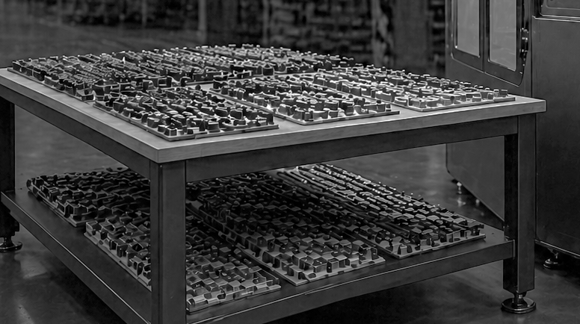
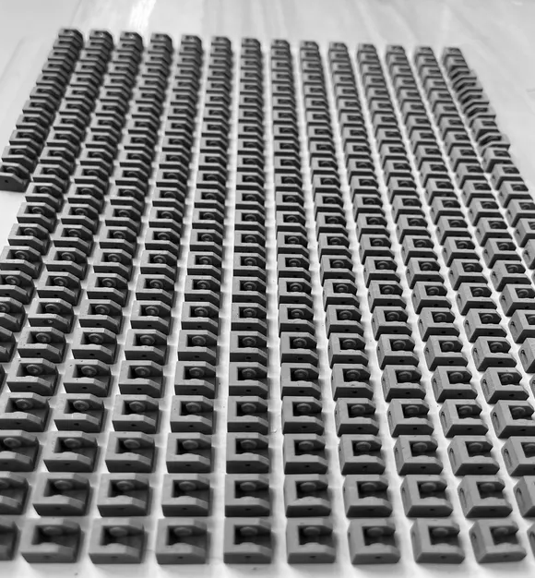
What is TMS?
  Tritone Manufacturing Service (TMS) is about production of parts on demand, using Tritone’s MoldJet technology, with or without secondary processing
  MoldJet technology is efficient in producing industrial quantities of moderate size, complex-shaped parts
  Together with our customers, we’ve established a global network of manufacturing services
This document is Tritone intellectual property; any copy is strictly prohibited

Slide 5
Ideal TMS Scope of Work
  Large quantities: once samples are approved by the customer, we want to see volumes
    >100 pieces in a 3-month term
    OR
    >1000 pieces in a 12-month term
  Minimum feasible Lead Time
    First samples: 4 weeks
    First batch: 6-8 weeks after approval of FAI / samples
Our Tip:
Avoid one-off prototyping and fixturing projects
This document is Tritone intellectual property; any copy is strictly prohibited

Slide 6
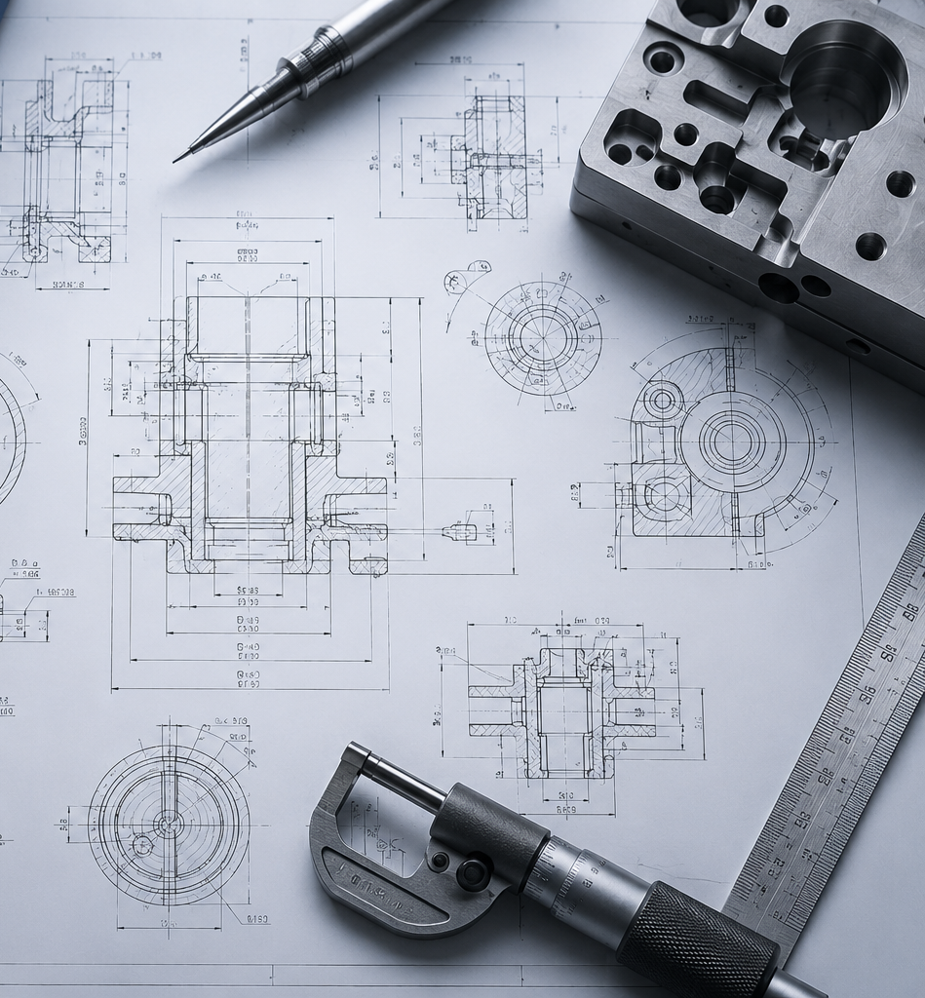

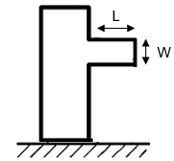
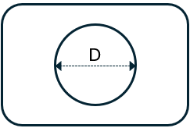
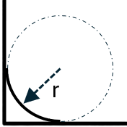

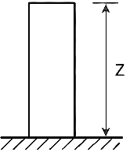
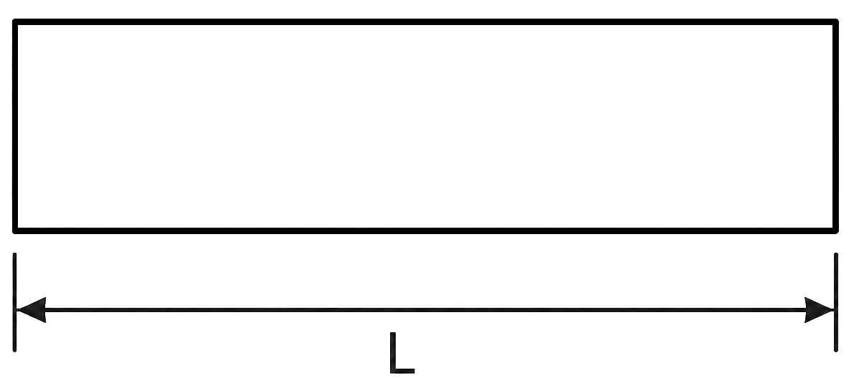
Ideal TMS Scope of Work
  Parts to be produced:
    Finished design, available as a solid-body CAD model (.sldprt / .X_t / .step)
    Technical drawings are available
    Material of choice is available on Tritone machines *
    Favorable geometry (see next slide)
* We do qualify new materials on demand, but this is a separate topic
This document is Tritone intellectual property; any copy is strictly prohibited

Slide 7
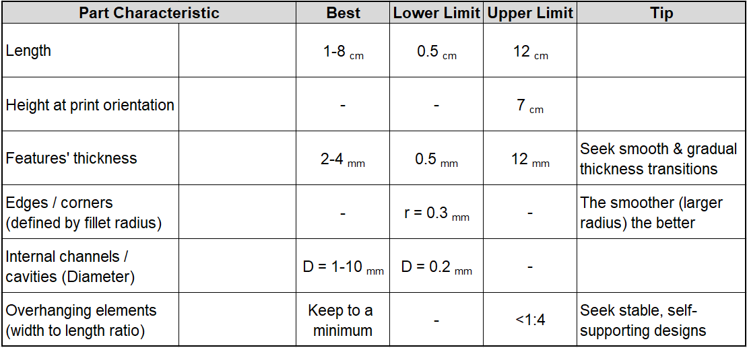
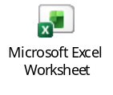
Part Geometry Characteristics
This document is Tritone intellectual property; any copy is strictly prohibited

Slide 8
Ideal TMS Customers
  See real added value in using MoldJet (not a mere price-competition situation)
  Come with a concrete need for parts (no intention of testing technology limits)
  Acknowledge the innovative nature of the technology
  Are authorized and open to revisiting part design, including relaxing traditional machining tolerances* and roughness** requirements. At the bare minimum, able to approve minor DfAM modifications (e.g. rounding sharp corners by adding fillets)
  Facilitate direct technical correspondence between the end-customer and us
* MoldJet can deliver tolerances of ±0.5% or ±50µm, the larger of the two
** MoldJet delivers roughness of 2-9µm (Ra) as-printed. This can be significantly improved by post-processing
This document is Tritone intellectual property; any copy is strictly prohibited

Slide 9
Thank you
www.tritoneAM.com | info@tritoneAM.com

