Slide 1
Tritone Technologies
The Industrial Solution for Metal & Ceramic Manufacturing

Slide 2




About Tritone Technologies
Founded in 2017, 1st system introduction Nov 2019
Novel Patented MoldJet AM technology
for metal and ceramic materials
Real and only industrial AM manufacturing
Company Overview
Privately owned, Backed by a leading Private Equity fund and
High throughput inkjet & paste deposition
This document is Tritone intellectual property; any copy is strictly prohibited

Slide 3
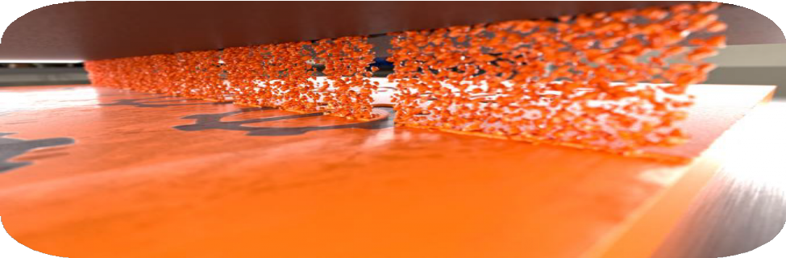
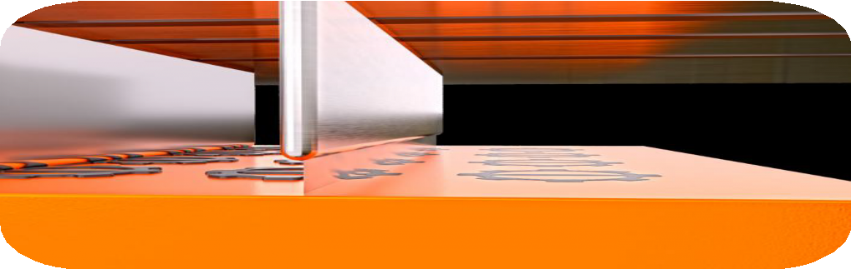
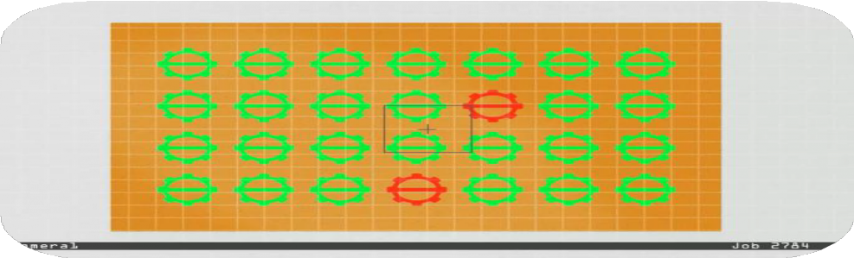
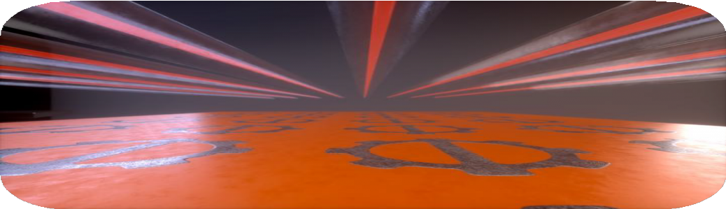
The MoldJet Process
Mold Printing
Material Deposition
Drying & Hardening
AI Inspection

Slide 4
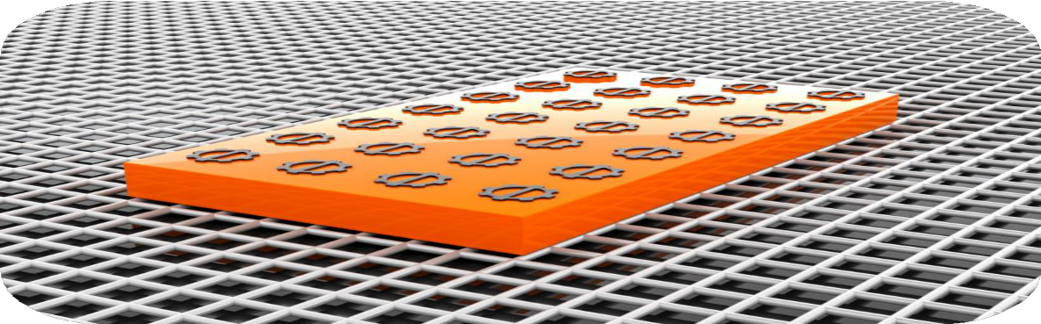
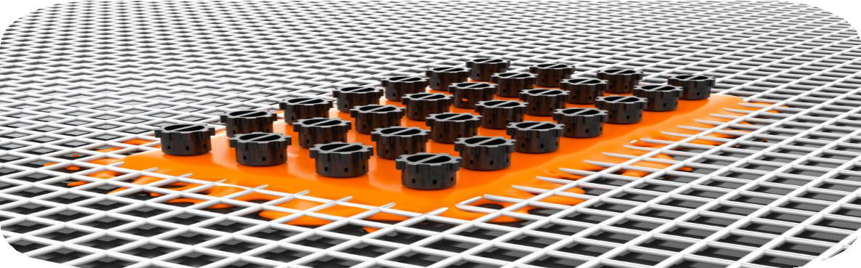
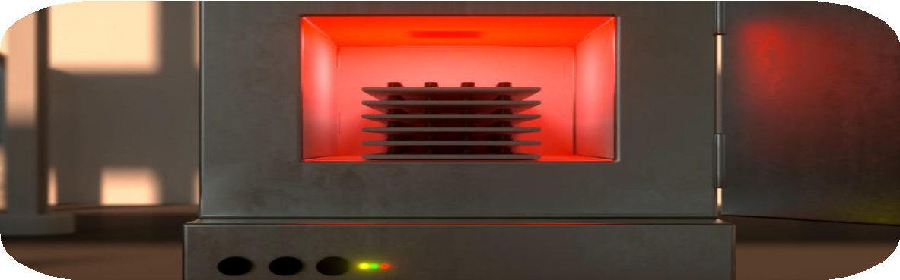
MoldJet Technology
Thermal Debinding & Sintering
Finished Tray
Demolding

Slide 5


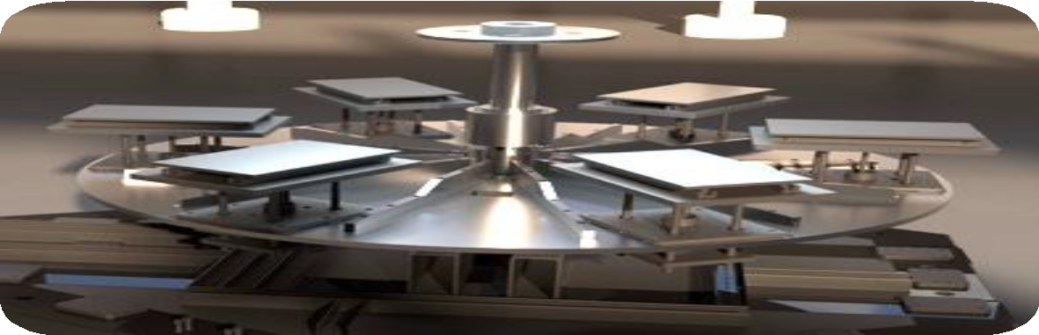



MoldJet Technology Overview
Dominant - 6 Independent Process Steps with Proven Industrial Format
Station 6 Inspection
Mold Printing Station 1
Station 5 Hardening
Paste Deposition Station 2
Drying Station 4
Drying Station 3
This document is Tritone intellectual property; any copy is strictly prohibited

Slide 6
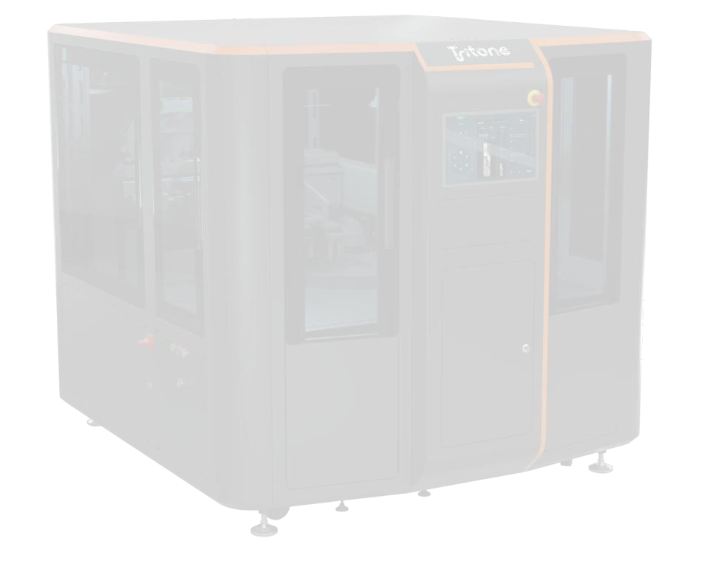
Tritone MoldJet Systems
System Specifications | Dominant | Dim
Build volume | 400 x 240 x 120 mm (L x W x H) | 220 x 120 x 90 mm (L x W x H)
Throughput | Up to 1,200 cc/h | 220 cc/h
Layer thickness | Versatile 25 – 150 µm | Versatile 25 – 150µm
Support material | Tritone Mold proprietary material | Tritone Mold proprietary material
Number of trays | 6, simultaneous and independent | 4, simultaneous and independent
Machine footprint | 3200 x 2200 x 1900 mm (L x W x H) | 2150 x 1960 x 1800 mm (L x W x H)
Weight | 2,300 Kg | 1,300 Kg

Slide 7
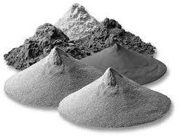
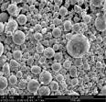
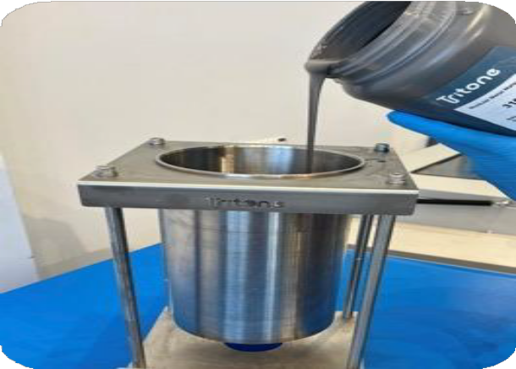
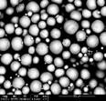
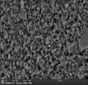
The Material Development Advantage
MoldJet’s *open system runs on a unified paste feedstock, enabling seamless transition from lab trials to mass production.
1 . Powder
Binding Agent
Carrier Liquid
Medium
*MoldJet is an open system which allows development of paste for different alloys materials – Tritone is
responsible for developing and selling the medium for the different alloys
This document is Tritone intellectual property; any copy is strictly prohibited

Slide 8



Unique Value Proposition
The Industrial Solution for Metal & Ceramic Manufacturing
Any material at an industrial scale
High Repeatability: Every part is produced with the same precision and quality—whether it’s the first, the hundredth, or the thousandth
High Throughput: Industrial speed, producing large volumes of parts quickly and efficiently
Industry Standard Material Properties: Our metal and ceramic parts match the strength, durability, and performance of industry-standard materials

Slide 9
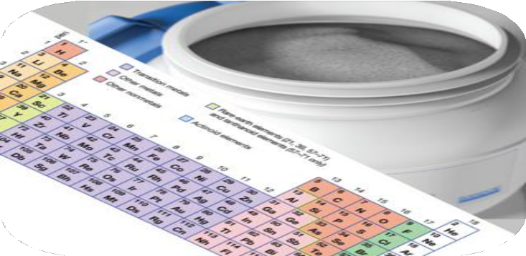
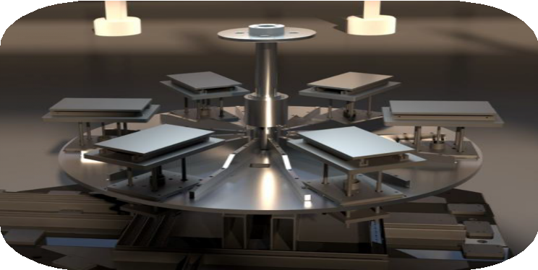
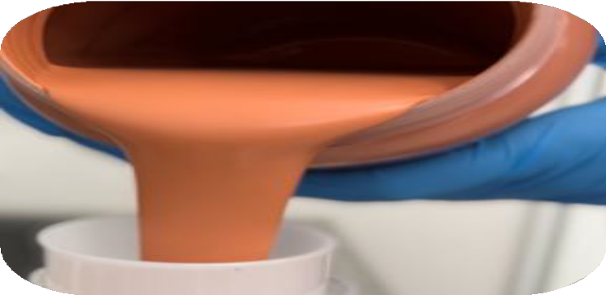
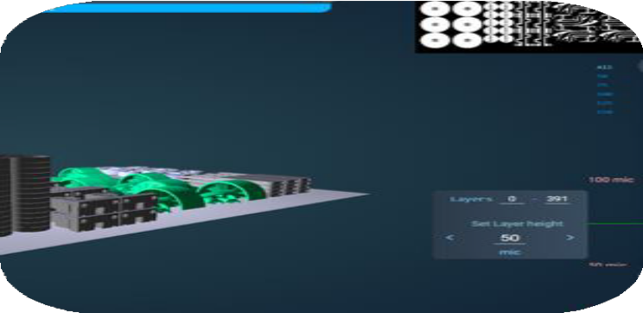
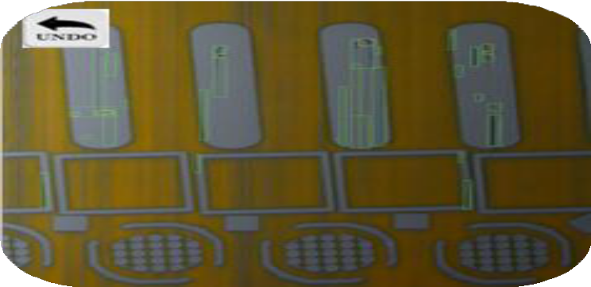
Key Advantages
Variety of Materials
Multiple Tray Process
No Loose Powder
Dynamic Variable Layer Thickness
AI Inspection &
Layer Correction

Slide 10















MoldJet vs. Legacy AM Technologies
Legacy AM Technologies
Powder Bed Fusion (Laser / EBeam) | Powder Bed Binder Jet | MoldJet®
Accuracy & Repeatability
Throughput
Exposure to Powders
System Flexibility (e.g., switching materials)
Material Variety
Parts Size
Post Processes

Slide 11
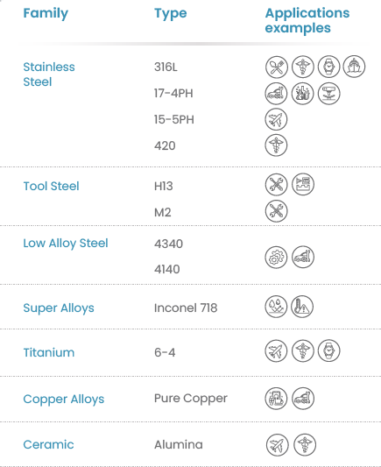
Materials

Slide 12
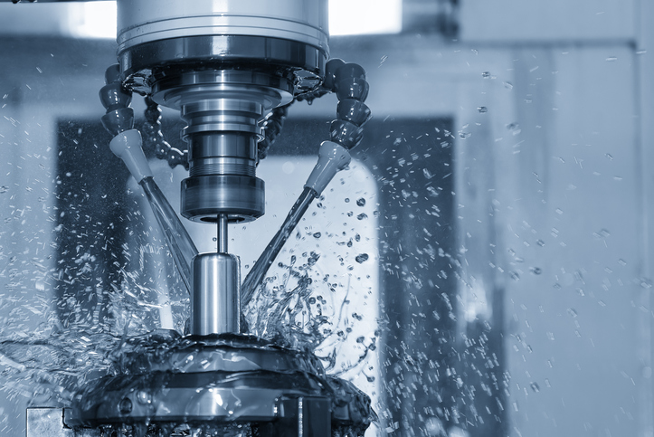
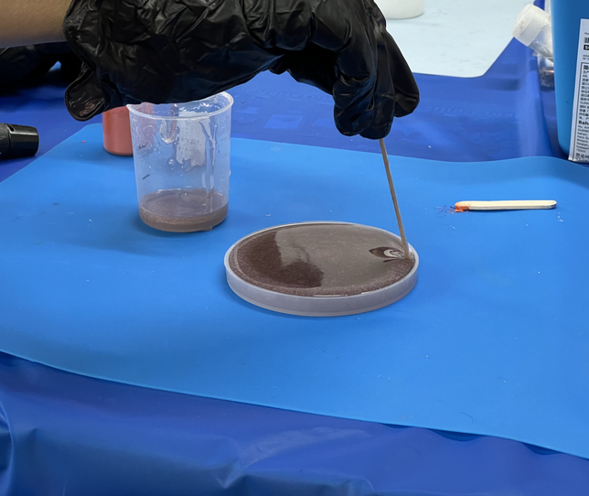
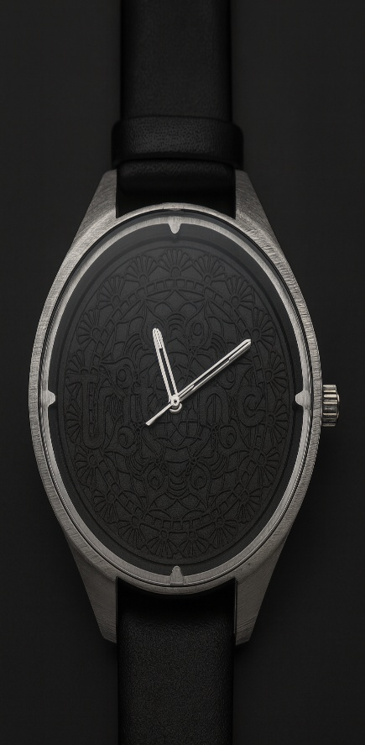
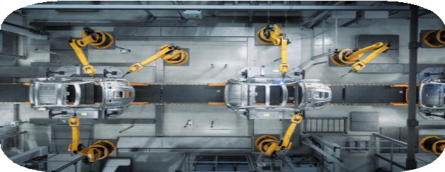
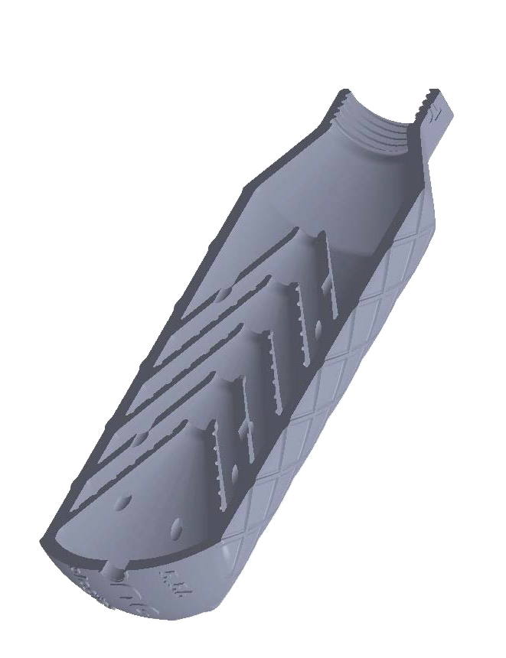

MoldJet’s High Industrial Fit – Segments
Primary
Secondary
EVs
Tooling
Research &
Education
Fashion
Defense & Aerospace
Medical
Device
10

Slide 13
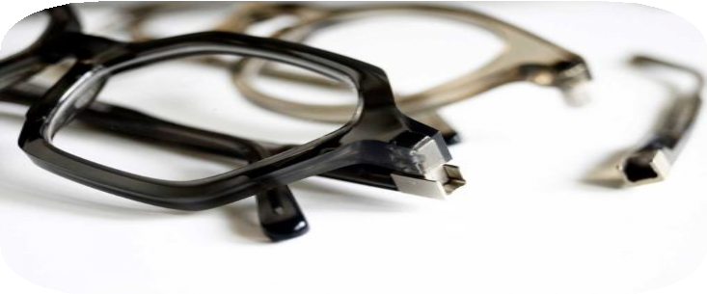
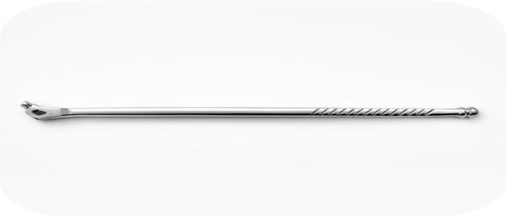
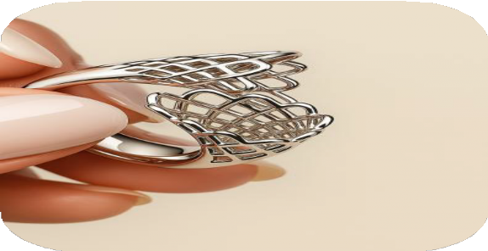
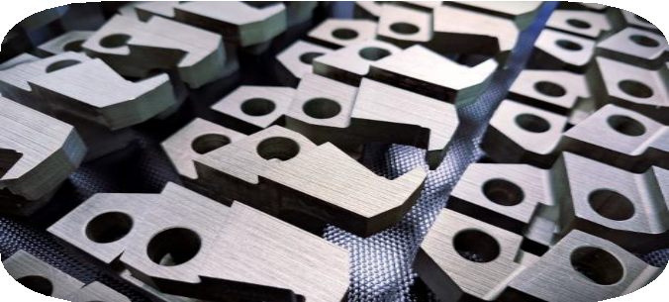
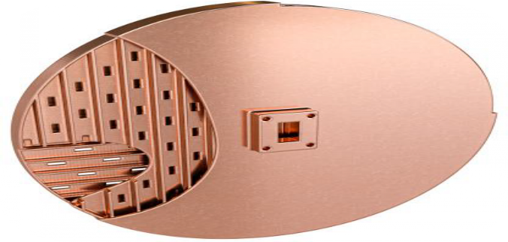
Applications
Eyeglass Hinges
Lumbar Angled
Driver
Optimized surface quality
Designer Ring
4,000 pairs ready in 8
hours
Lightweight complex design
Jaw Grippers
RF Slotted Antenna
X3 Cost reduction
270 parts in 4 hours Pure Copper
11

Slide 14

www.tritoneAM.com

